Slide 1
Galavant
DME Project by Ivan Ong and Joel Heer
Oh and Ek Hern…

Slide 2

About Us
Castaways was formed by a group of Students who happened to share a common cause.
We strive to lend a helping hand towards alleviating the barrier between man and technology.

Slide 3
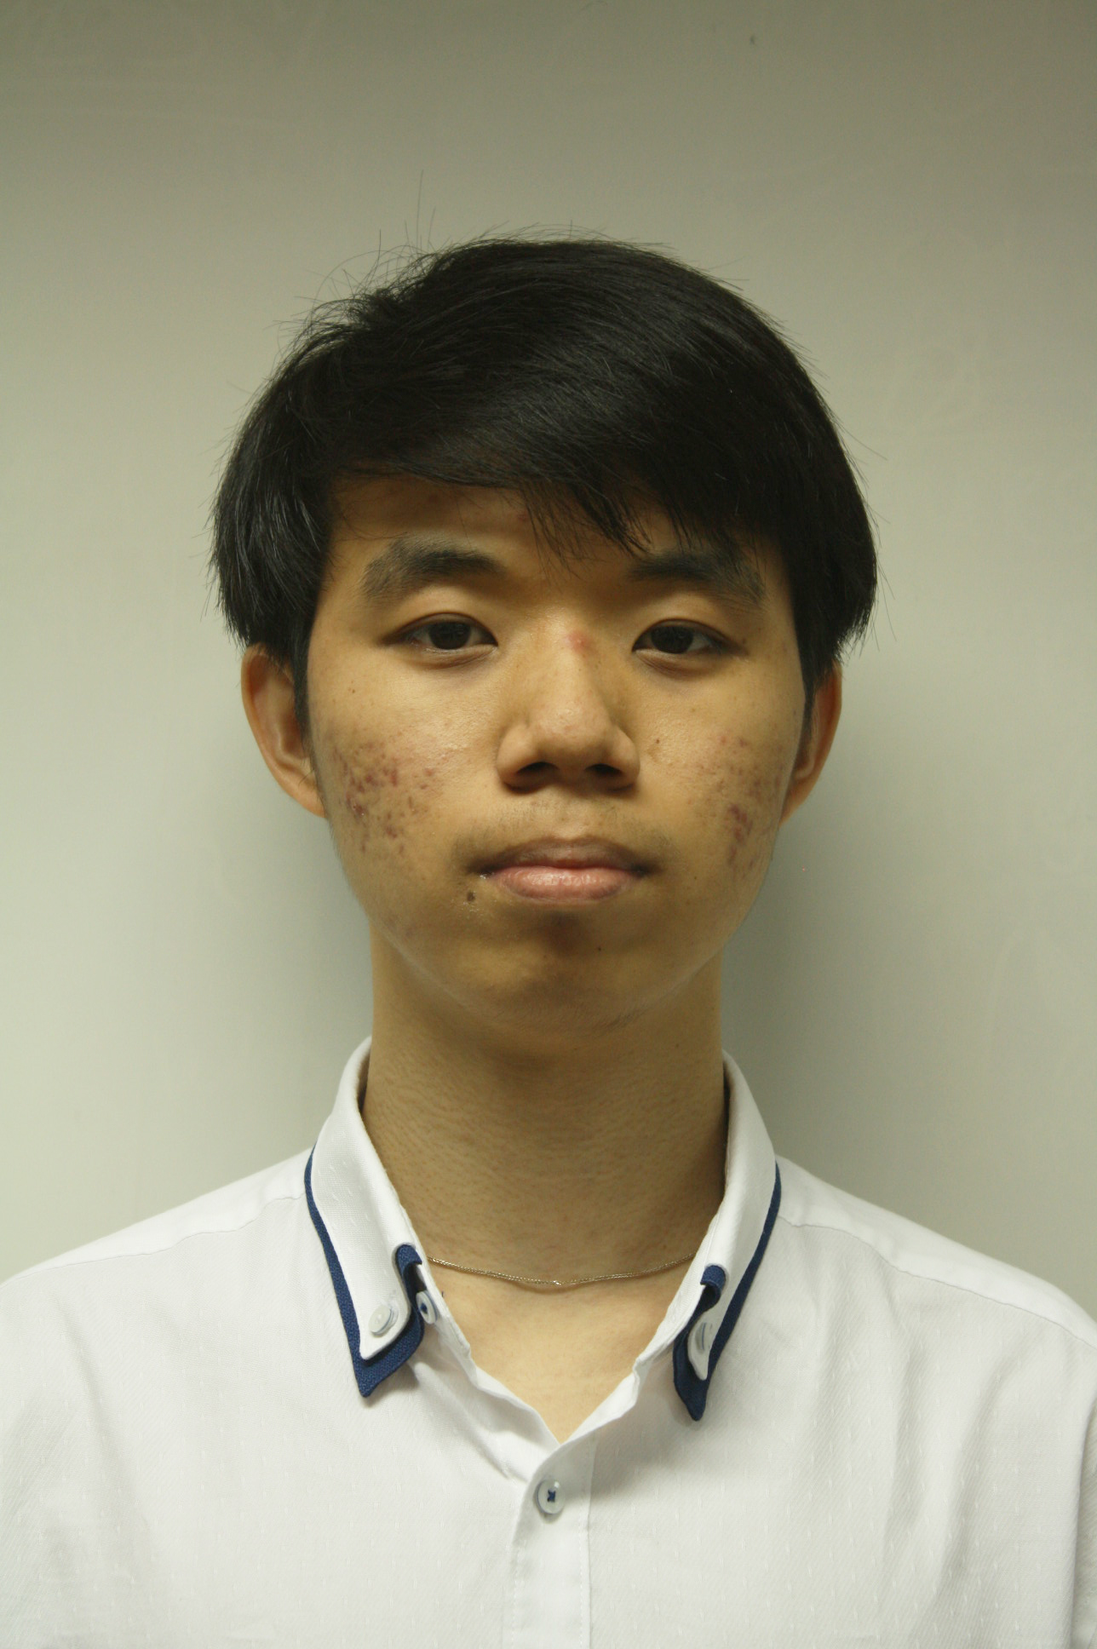
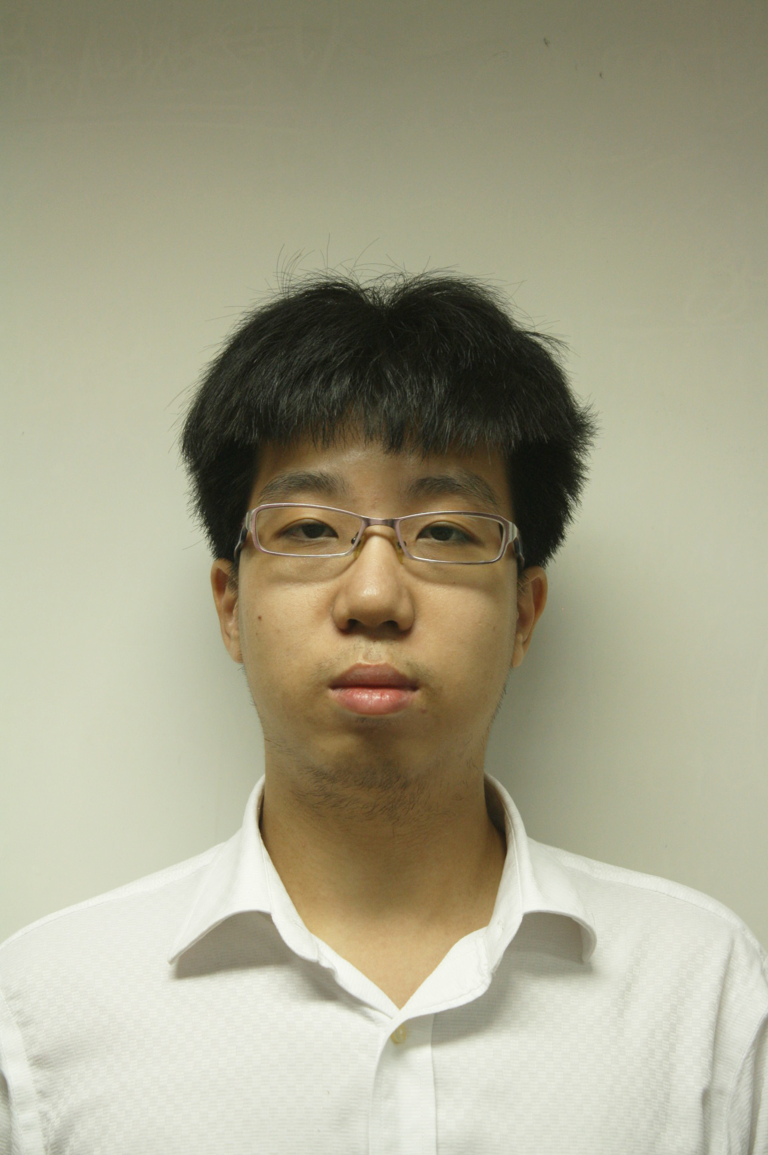
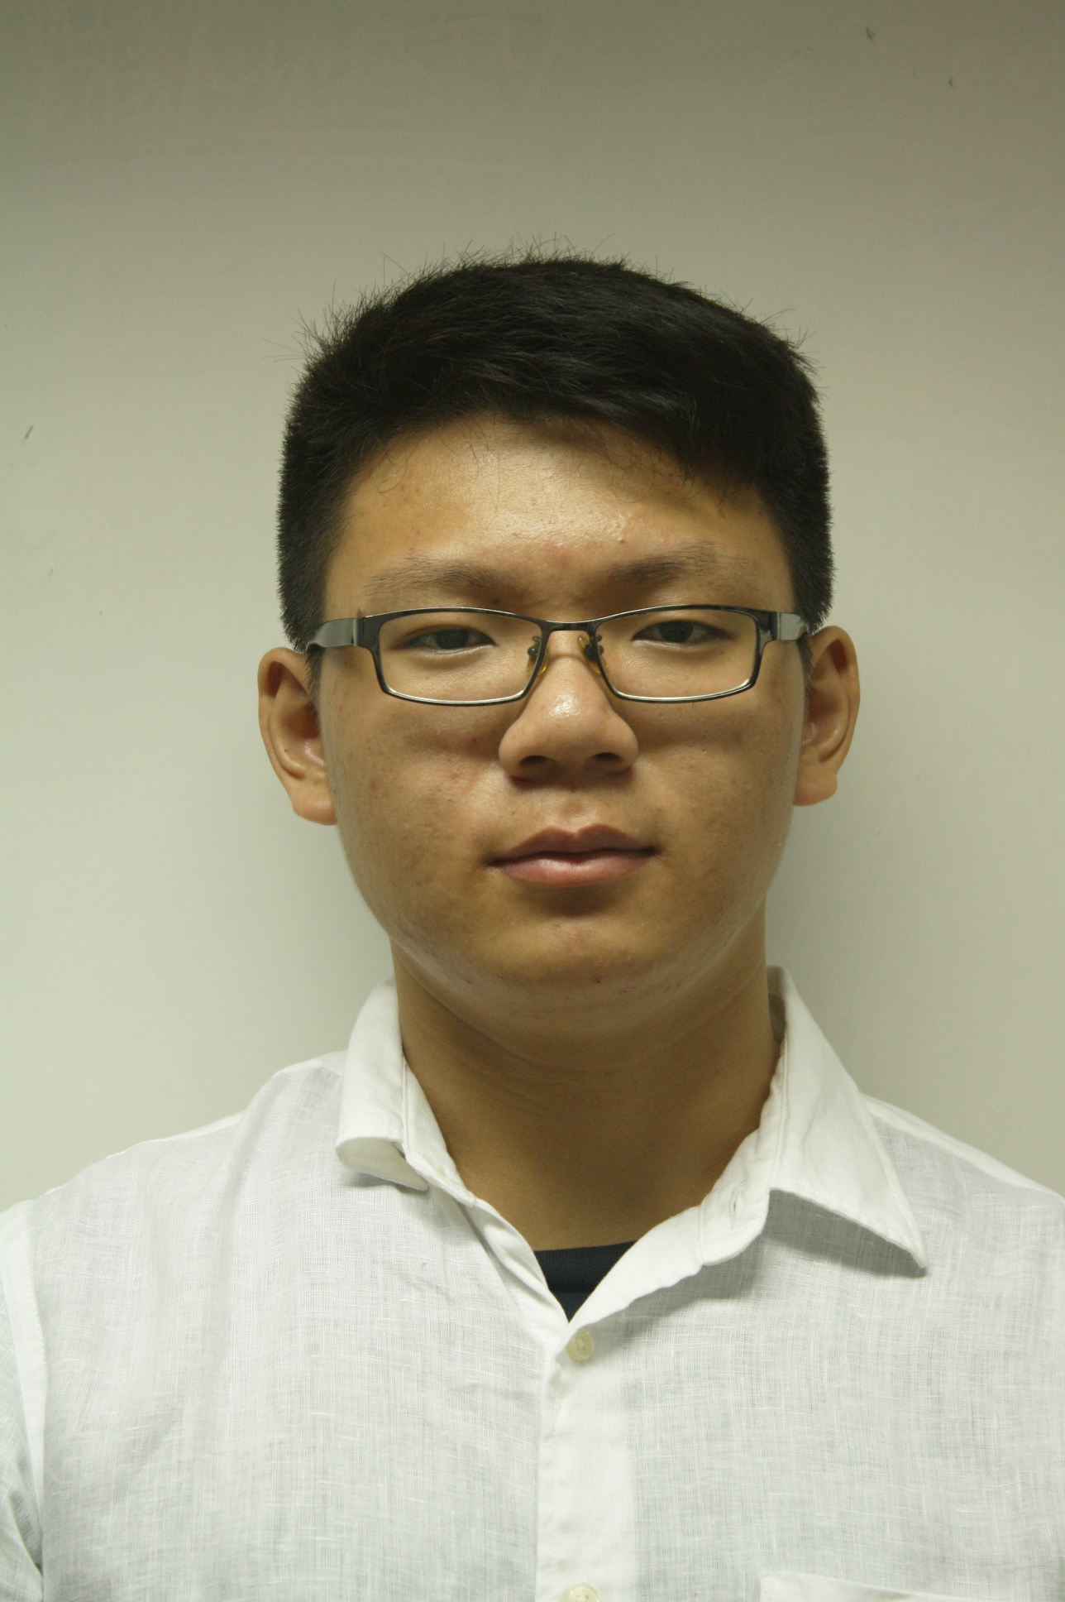
The Team
Ivan Ong
Front End Programming
Lead Designer
Joel Heer
Back End Programming
Ek Hern
Documentation
3D modeling

Slide 4
Our Theme
Enhanced Tourism
Aim to augment a visitor’s experience as well as encourage return visits
Give users a lasting memento to keep

Slide 5
Galavant
Unlock 3D models of tourist sites
Unlock by scanning QR code (model remains unlocked permanently for that account)
Complete collections by visiting all the destinations

Slide 6
App Demo

Slide 7
Target Audience & Platform
Designed for Mobile Devices
Tourists and people traveling to Singapore in general
Youth and Young Adults with mobile devices
Kleptomaniacs

Slide 8

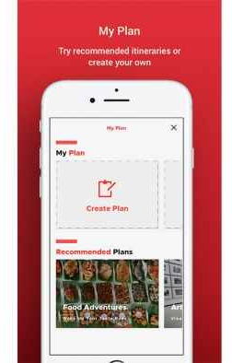
Competitor Apps
Singapore Travel Guide App
Features maps that display places of interest near the user’s location
Socializing feature that allows users to find other people with similar interests
Also features the ability to chart a route between destinations of interest

Slide 9
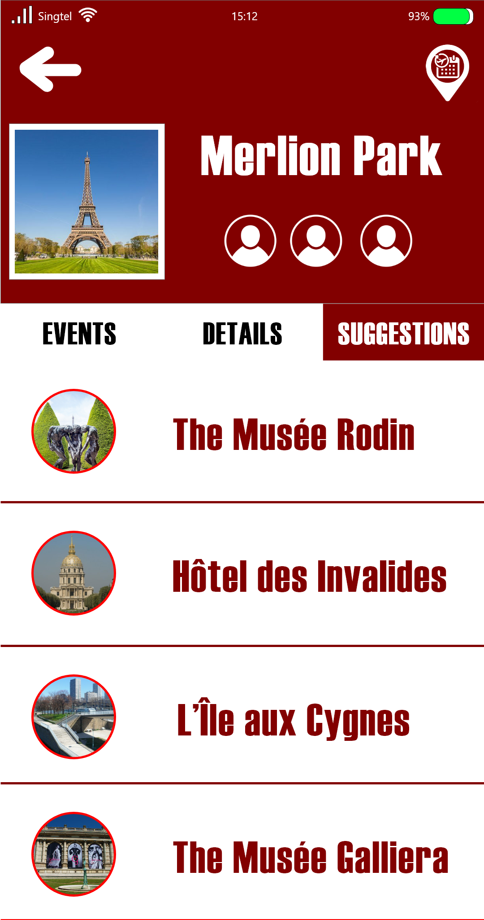

App Design
Modern look. Does not deviate too far from conventional standards
Simple and intuitive layout
Deep red-brown paired with white

Slide 10
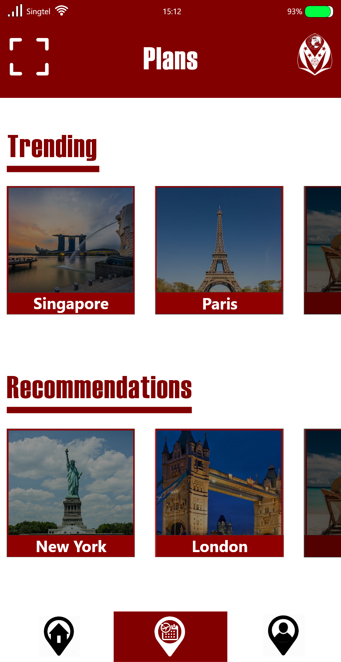
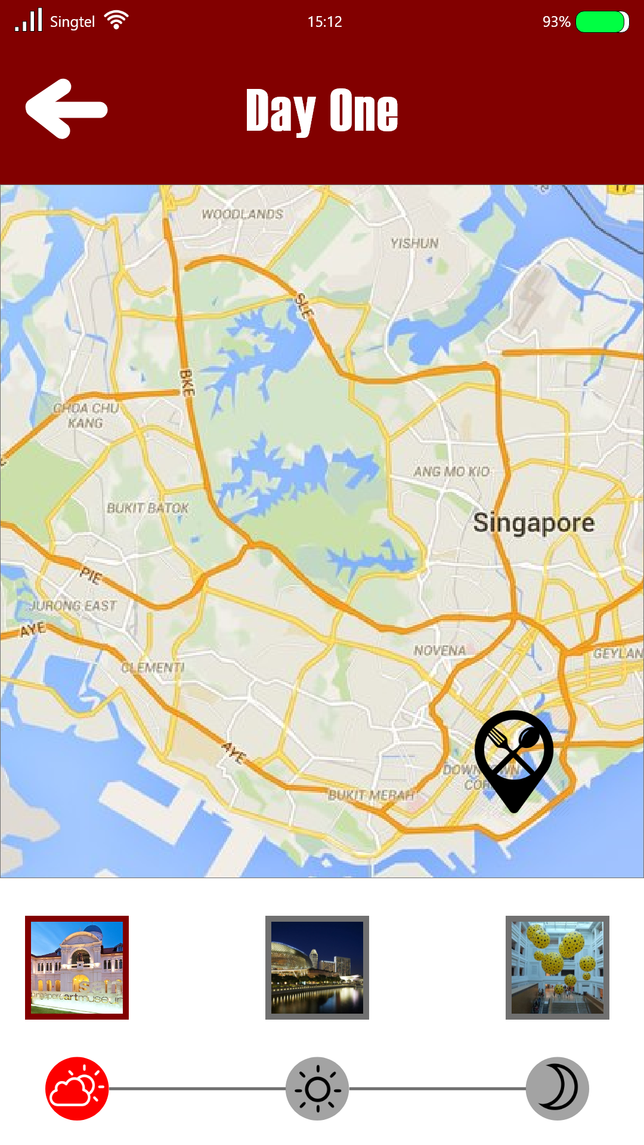
App Design

Slide 11




Emblem Design
Designated for the fun collectors function
Intended to bring a necessary twist to draw appeal for the application
Resemble that of crests which carry significant elements from various countries, starring stars, symbols and layout
Unique designs for each country

Slide 12
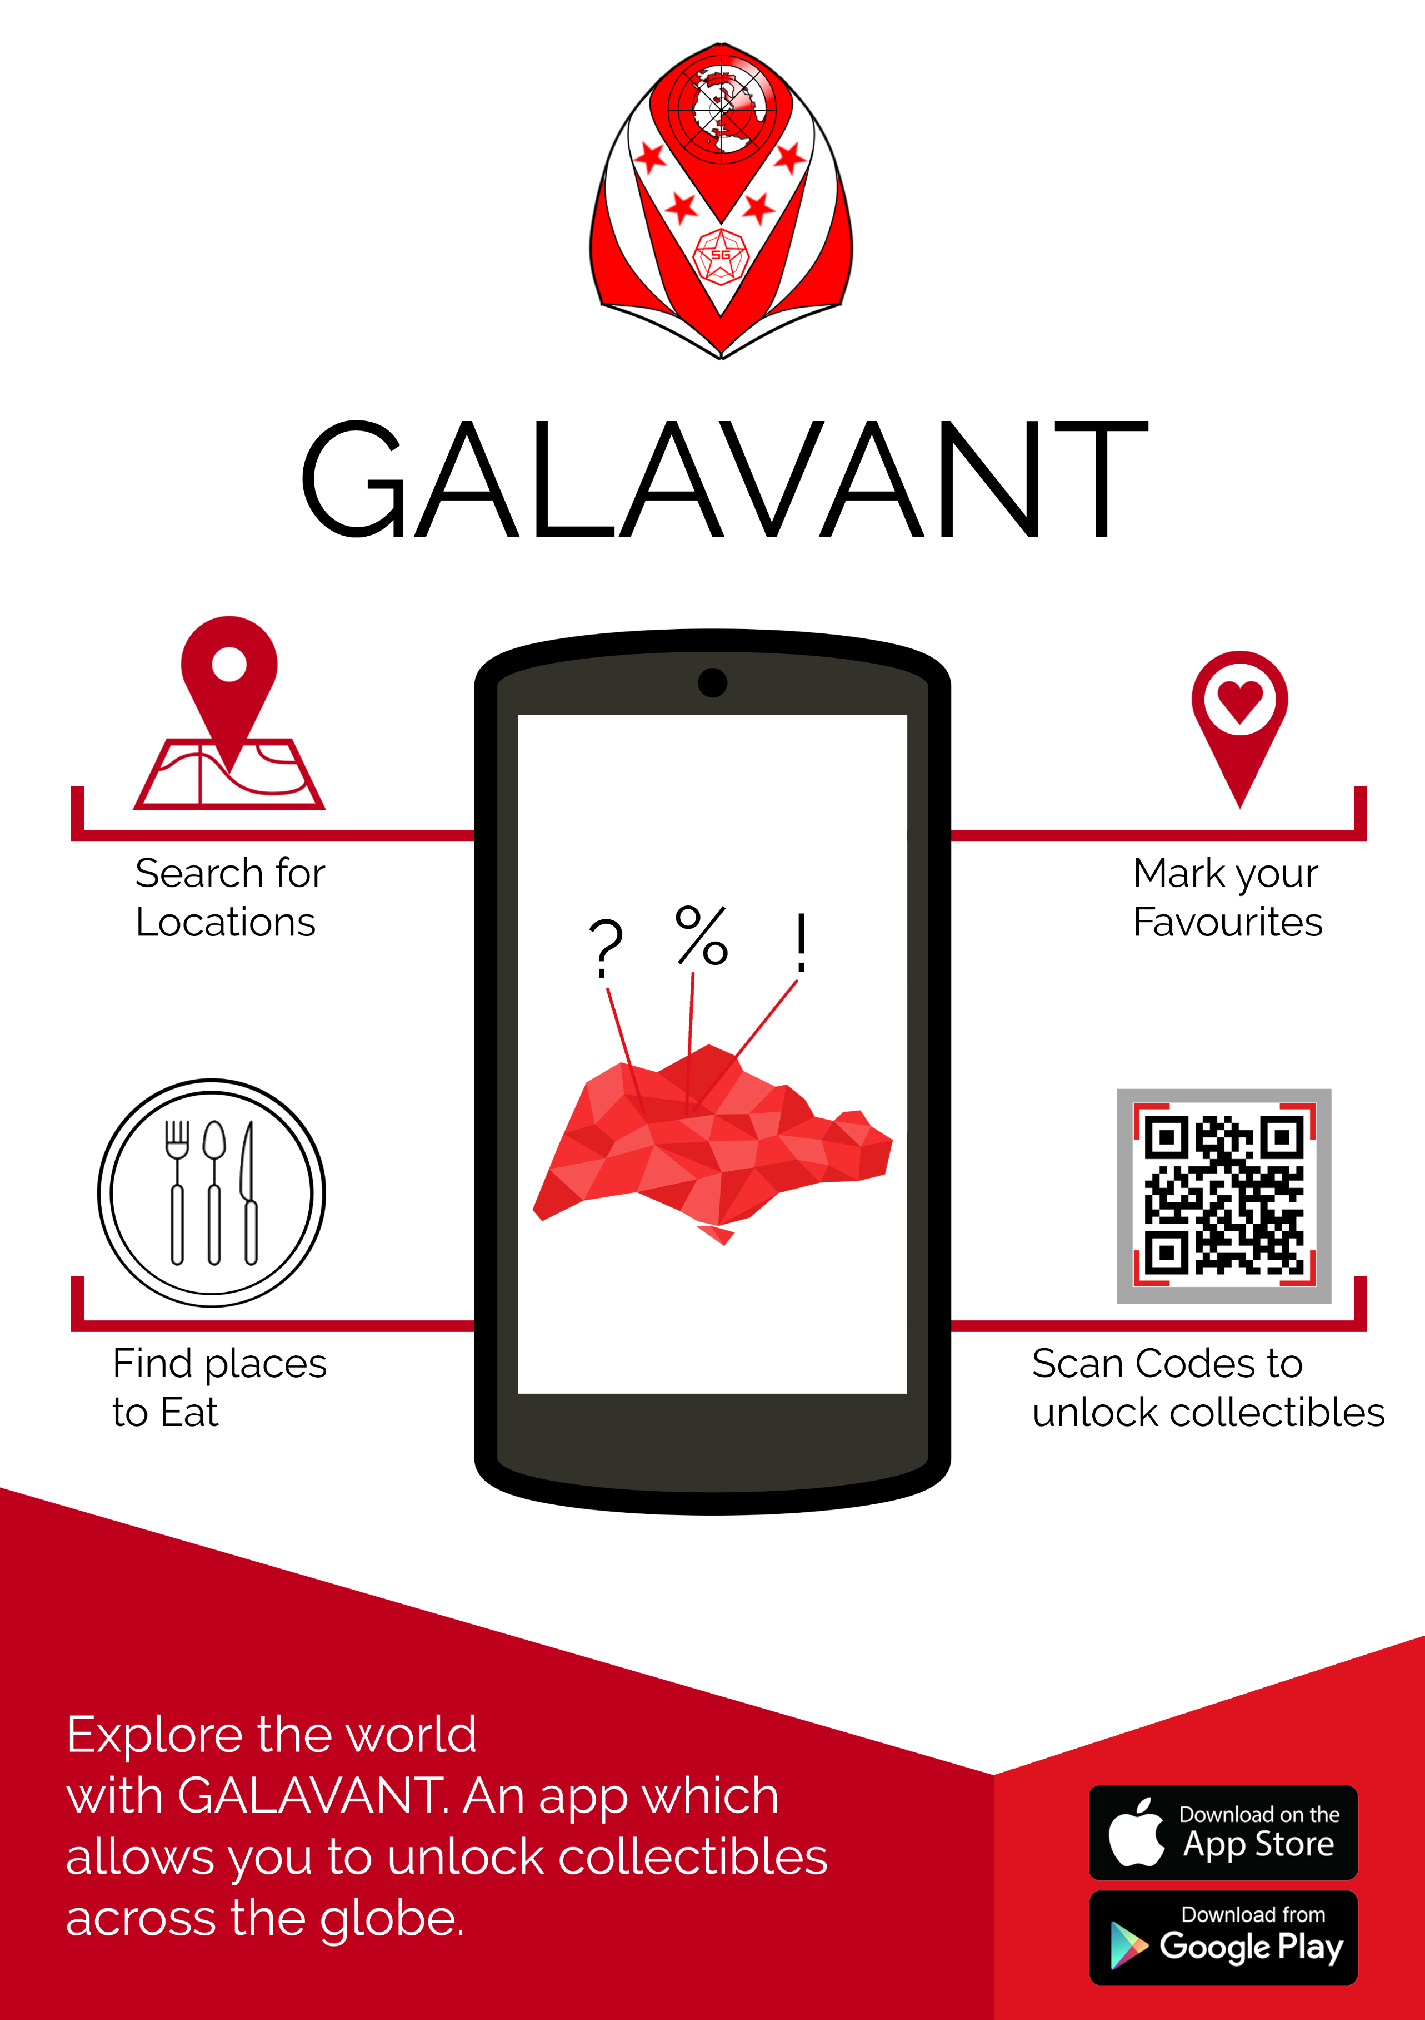
Marketing Plan
Example Poster

Slide 13
Expected Features
Locate destinations of interest (Map)
3D Model “Collection” feature
QR codes “treasure hunt”
Plan routes between destinations (Map)
Display information on landmarks and Destinations

Slide 14
Final Product Features
Custom Google Maps Controls
QR Code Reader
3D Model Display

Slide 15
Thank You for Your Time
Any questions? (If we didn’t screw up)

